Slide 1
Introduction to DSP
Definition:
  DSP
  It refers to:
    Digital Signal Processing: Signal processing by digital means
    Digital Signal Processor: Specialized microprocessor that can process signals in real-time
  To avoid confusion, we are referring to “Digital Signal Processing” unless otherwise stated
Notes:
Digital Systems: Hardware Organization and Design
Architecture of a Respresentative 32 Bit Processor

Slide 2
Introduction to DSP
Signal – a detectable physical quantity or impulse (as a voltage, current, or magnetic field strength) by which messages or information can be transmitted (Webster Dictionary)
Notes:
Digital Systems: Hardware Organization and Design
Architecture of a Respresentative 32 Bit Processor

Slide 3
Introduction to DSP
Signal Characteristics:
  Signals are Physical Quantities:
  Signals are Measurable
  Signals are Analog
  Signals Contain Information.
Examples:
  Temperature [ºC]
  Pressure [Newtons/m²] or [Pa]
  Mass [kg]
  Speed [m/s]
  Acceleration [m/s²]
  Torque [Newton*m]
  Voltage [Volts]
  Current [Amps]
  Power [Watts]
In this class, analog signals are electrical.
  Sensors: are devices that convert other physical quantities (temperature, pressure, etc.) to electrical signals.
Notes:
Digital Systems: Hardware Organization and Design
Architecture of a Respresentative 32 Bit Processor

Slide 4
Introduction to DSP
DSP systems process digital signals:
  Analog-to-Digital Converter (ADC)
    Binary representation of the analog signal
  Digital-to-Analog Converter (DAC)
    Digital representation of the signal is converted to continuous analog signal.
Analog ⇔ Continuous
Notes:
Digital Systems: Hardware Organization and Design
Architecture of a Respresentative 32 Bit Processor

Slide 5
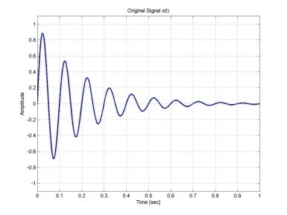
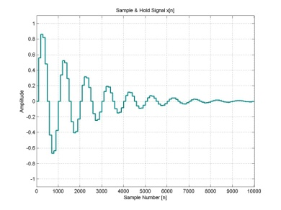
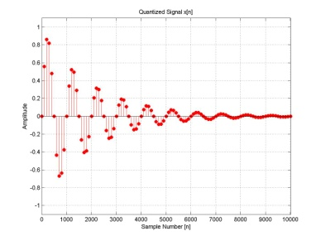
ADC
a) Continuous Signal
b) Amplitude Quantized Signal
f_{s}
x(t)
Analog
Low-pass
Filter
Sample
and
Hold
x_{a}(nT)
Quantizer
x[n]
DSP
c) Amplitude & Time Quantized – Digital Signal

Slide 6
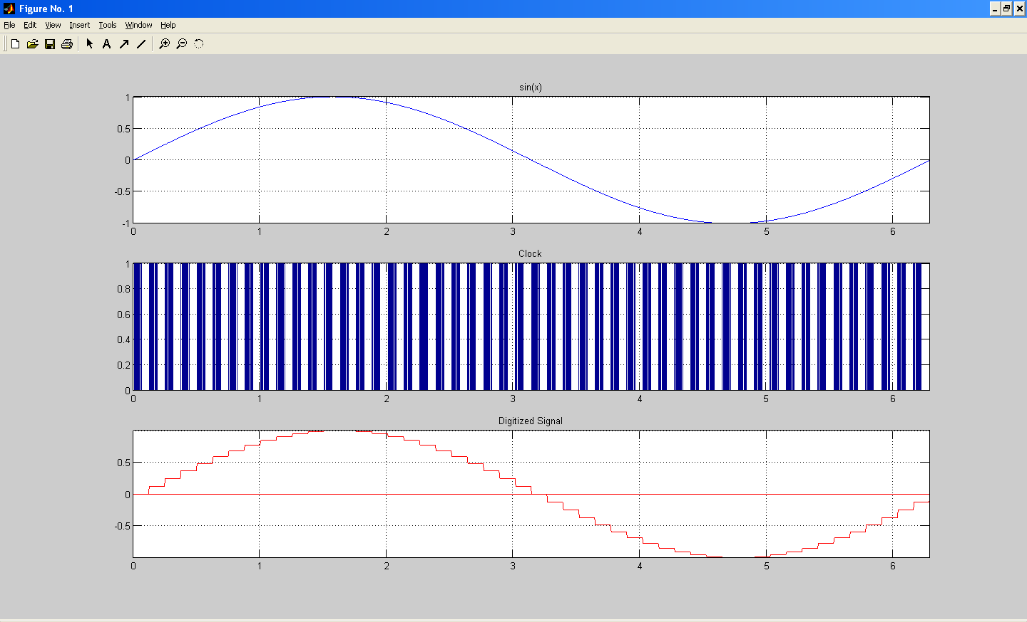
Example of ADC
Notes:
Digital Systems: Hardware Organization and Design
Architecture of a Respresentative 32 Bit Processor

Slide 7
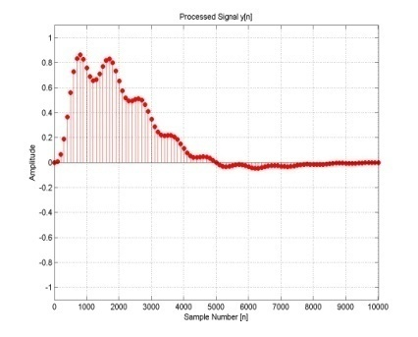
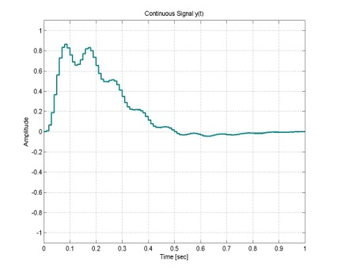

DAC
a) Digital Output Signal
b) Analog Signal
c) Continuous Low-pass filtered Signal
DSP
Digital to
Analog
Converter
Analog
Low-pass
Filter
y(t)
y[n]
y_{a}(nT)

Slide 8
Typical Architecture of a DSP System
Analog Signal Processing
Sensor
Analog Signal
Conditioning
Digital Signal Processing
ADC
Digital Signal
Conditioning
DSP
DAC
Notes:
Digital Systems: Hardware Organization and Design
Architecture of a Respresentative 32 Bit Processor

Slide 9
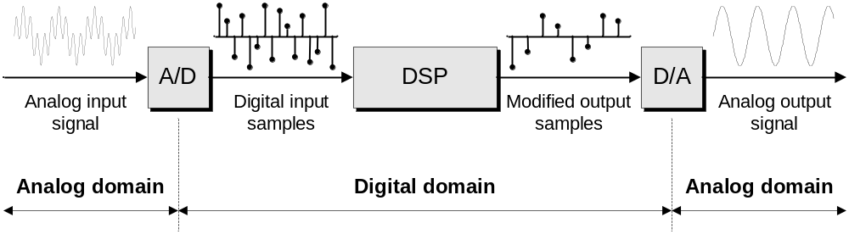

Slide 10
Lab 2
FPGA
FLASH
Memory
Sequential and
Combinational Logic,
including FSMs
D/A
Converter
Speaker
LCD
Buttons
Keyboard

Slide 11
What Kind of Processing?
Extraction of Information
  Amplitude
  Phase
  Frequency
  Spectral Content
Transform the Signal
  FDMA (Frequency Division Multiple Access)
  TDMA (Time Division Multiple Access)
  CDMA (Code Division Multiple Access)
Compress Data
  ADPCM (Adaptive Differential Pulse Code Modulation)
  CELP (Code Excited Linear Prediction)
  MPEG (Moving Picture Experts Group)
  HDTV (High Definition TV)
Generate Feedback Control Signal
  Robotics (ASIMOV)
  Vehicle Manufacturing
  Process Control
Extraction of Signal in Noise
  Filtering
  Autocorrelation
  Convolution
Store Signals in Digital Format for Analysis
  FFT
  …
Notes:
Digital Systems: Hardware Organization and Design
Architecture of a Respresentative 32 Bit Processor

Slide 12
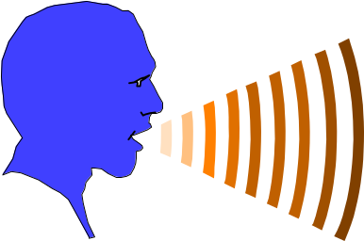
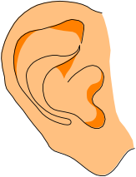
Signal Processing Applications
Speech processing
  Speech compression
  Speech recognition
  Speaker Identification, Verification
  Speech synthesis
  Speech enhancement, Echo cancellation
Audio Processing
  Compression
  3-D reproduction

Slide 13

DSP Applications – Image Processing
Image Processing
  Image compression
  Pattern recognition
  Ghost cancellation
  Noise reduction
  Deblurring
  Object tracking
  Image fusion
Video Processing/compression, tracking...

Slide 14
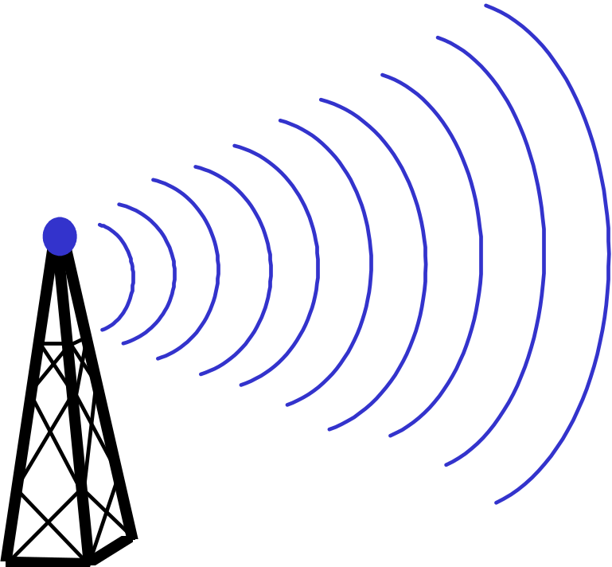
DSP Applications Communications
MODEM
  correlators (matched filters)
  echo cancellers
  equalizers
Cellular Telephony
  speech compression
  diversity combining
  array processing
Software Radio

Slide 15
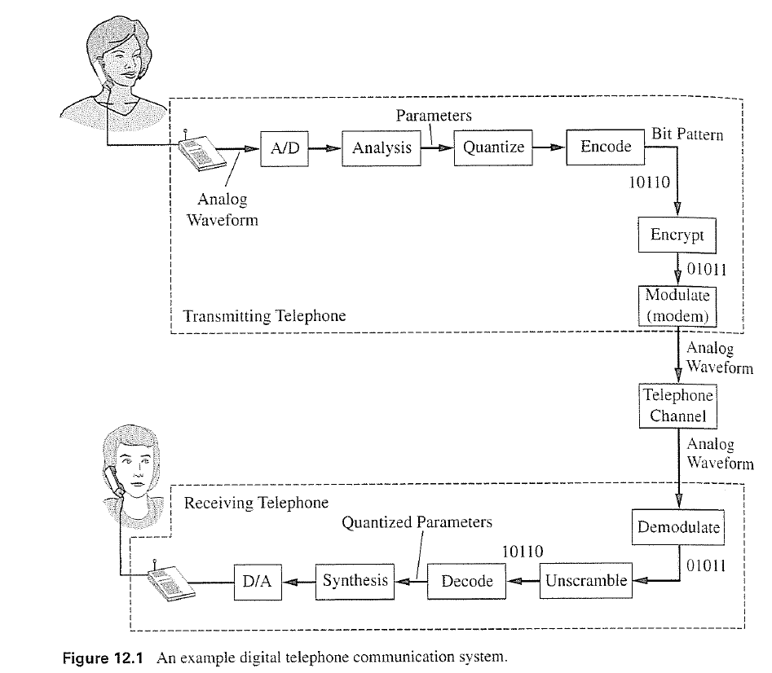
Digital Telephone Communication System Example:
Notes:
Digital Systems: Hardware Organization and Design
Architecture of a Respresentative 32 Bit Processor

Slide 16
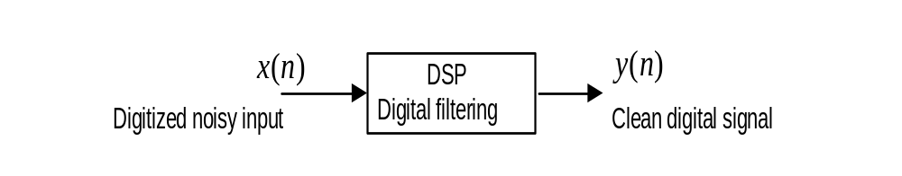
DSP Examples
Digital filtering to remove noise to obtain a clean signal

Slide 17
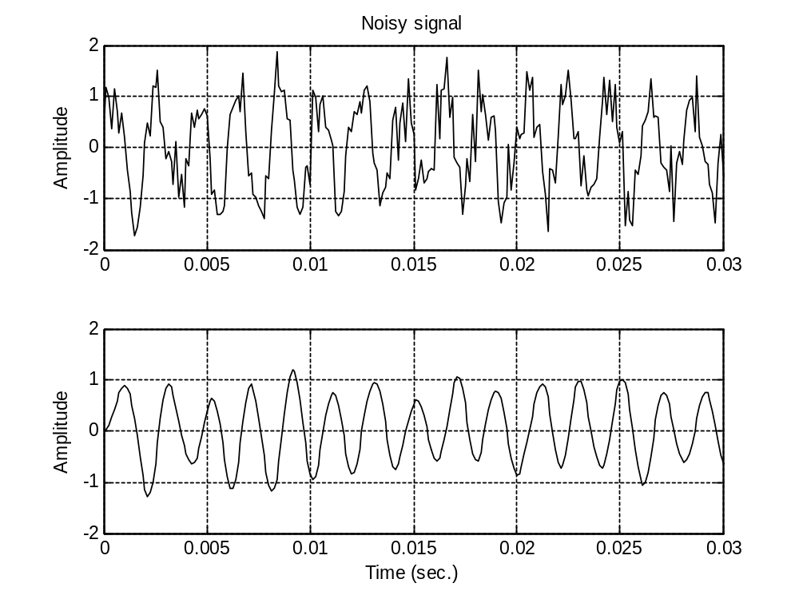

Slide 18
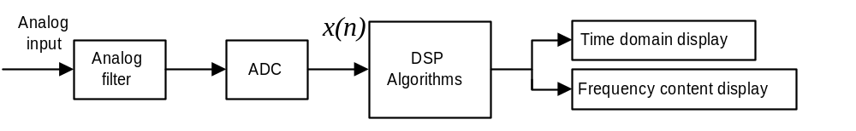
Signal spectral analysis
Plot and display frequency information of the digitized signal

Slide 19
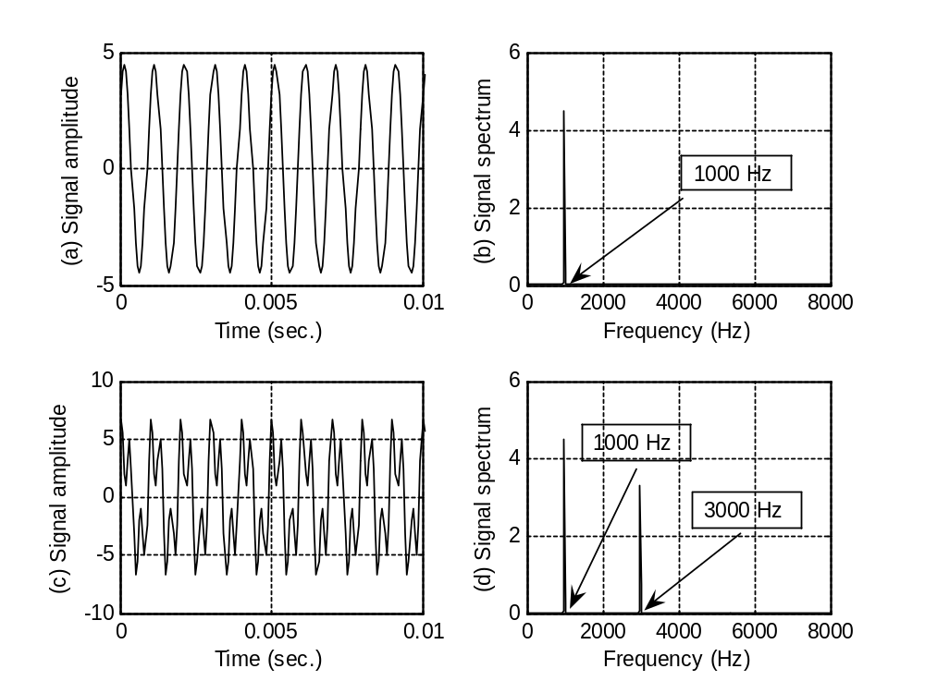

Slide 20
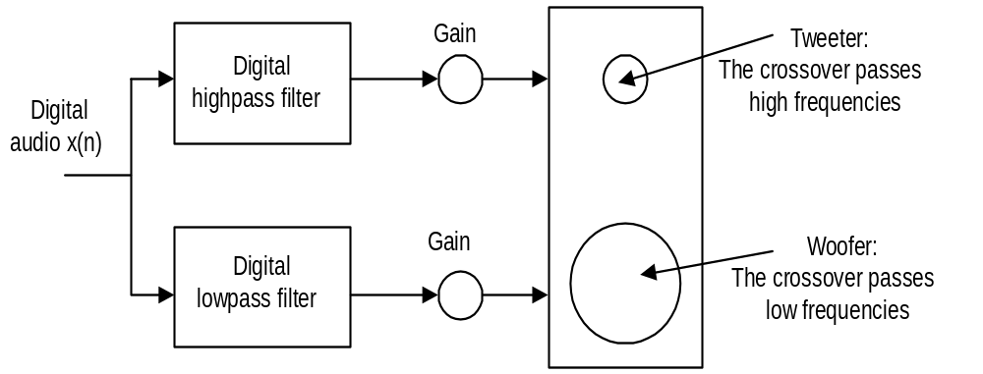
Applications of DSP
Digital crossover system

Slide 21
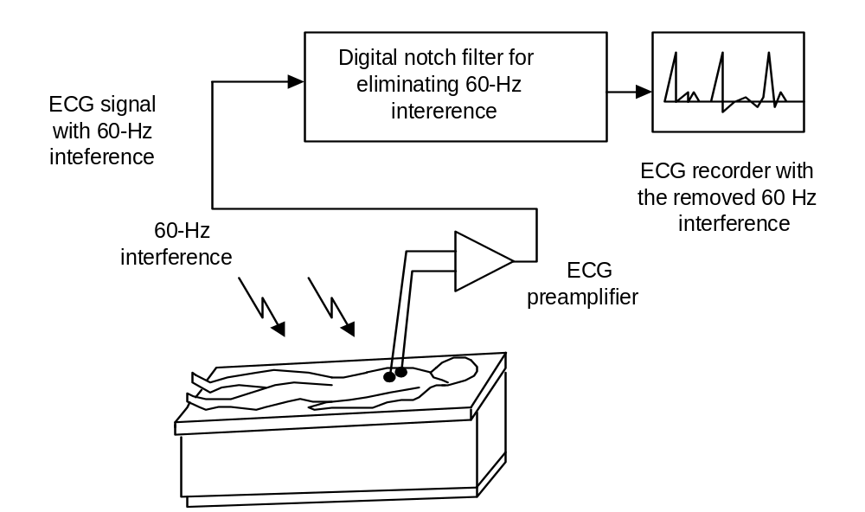
Interference cancellation in Electrocardiograph (ECG)

Slide 22
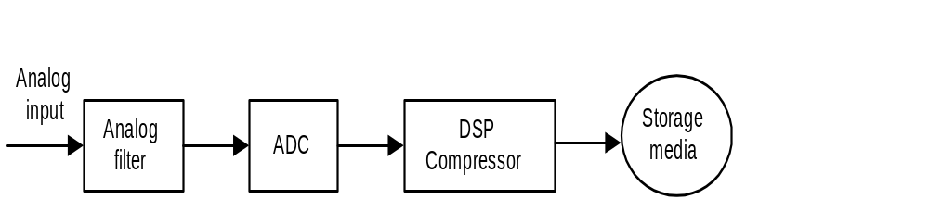
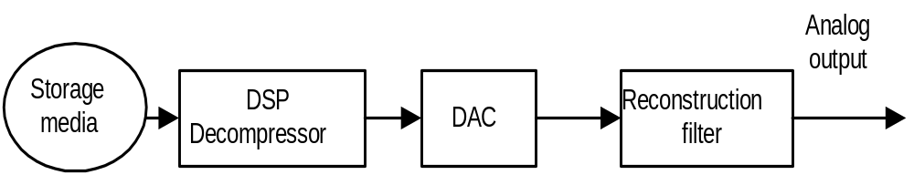
Speech coding and compression

Slide 23
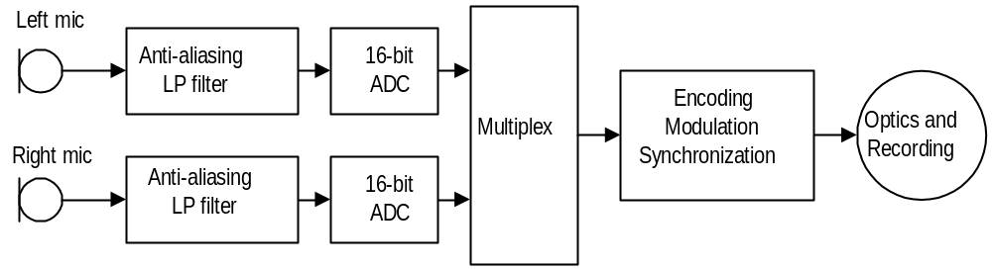
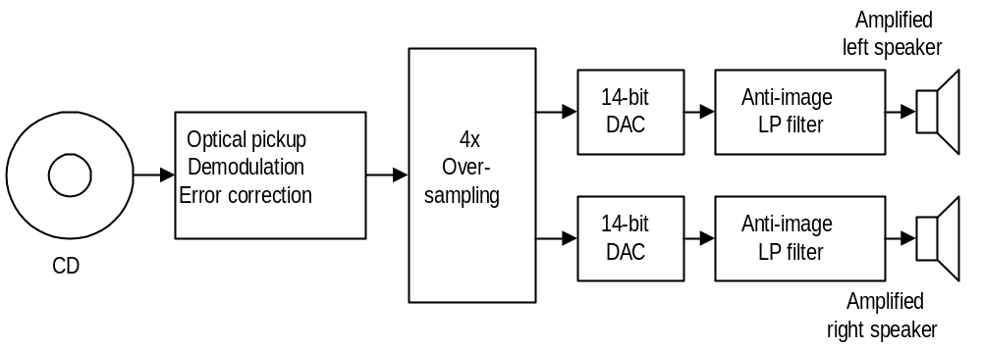
CD recording system

Slide 24
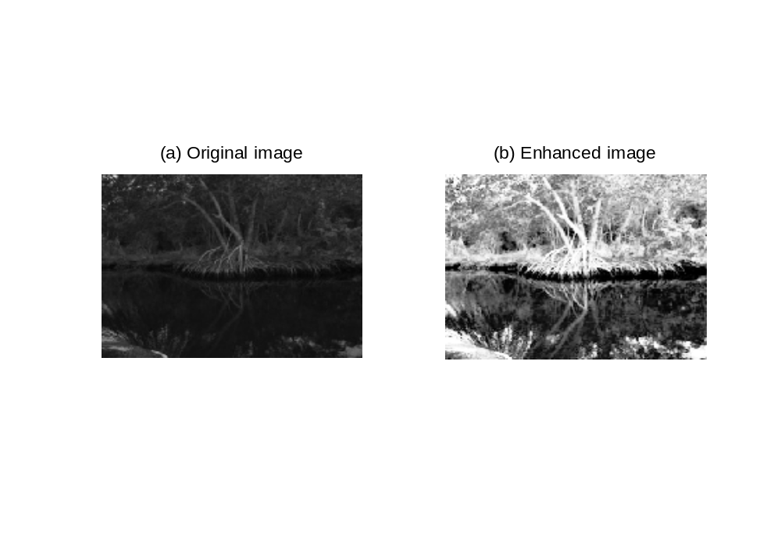
Digital image enhancement

Slide 25
Image Histogram and Equalization
Image histogram is a graph to show how
many pixels occurring at each scale level, or
at each index for the indexed color image
Image equalization stretches image pixel
values to give a reasonable contrast based
on the image histogram

Slide 26
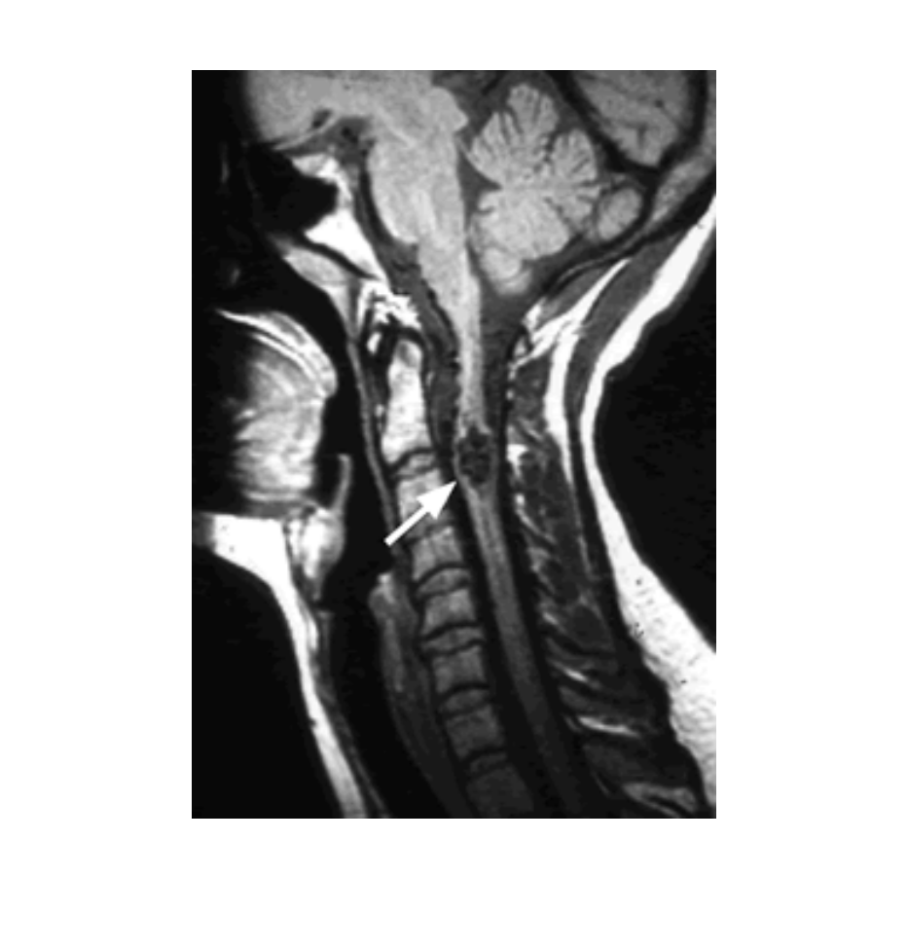
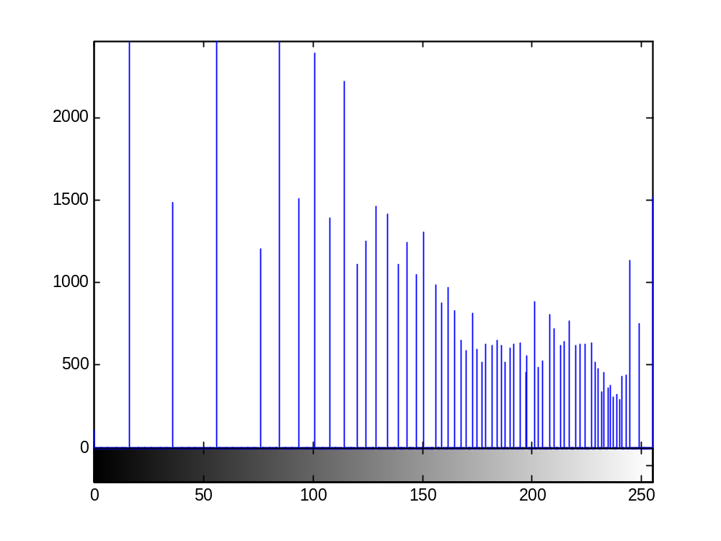
Image Histogram

Slide 27
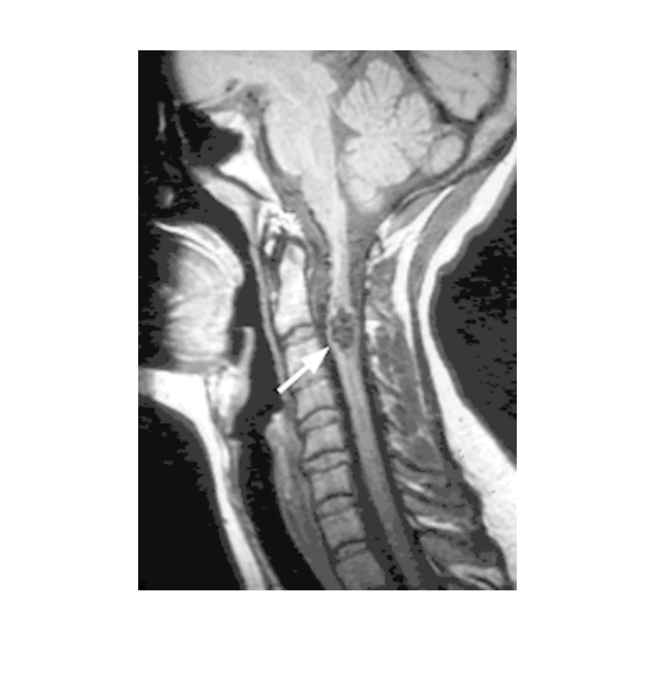
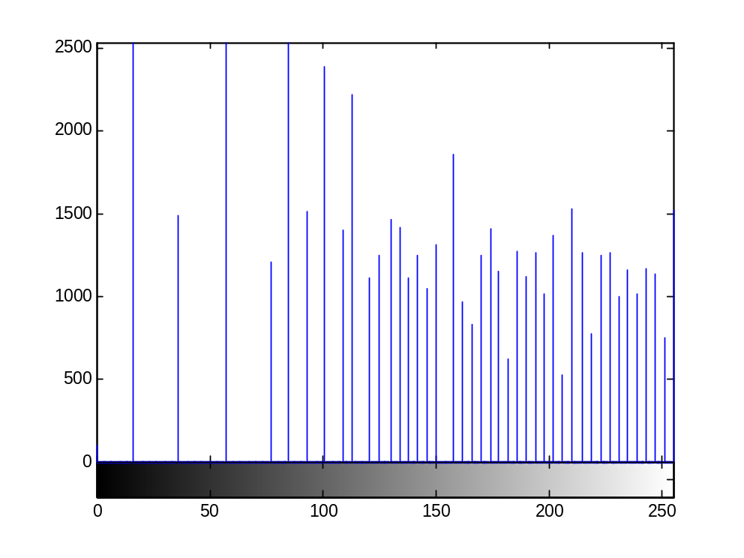
Equalized image Histogram

Slide 28

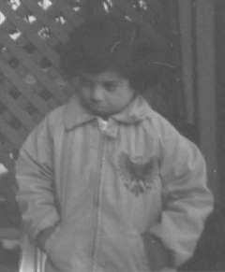

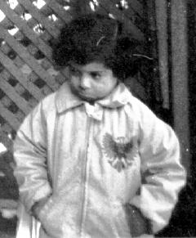


Image Enhancement
Blurred or faint edges
Low contrast or dynamic range
Noise
⇓
Sharpen faint or blurred edges
Modify low dynamic range
⇓
⇓
Remove noise

Slide 29
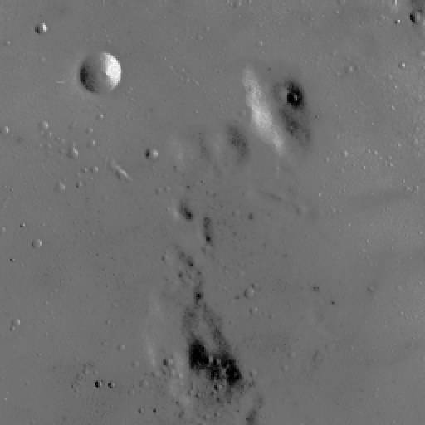
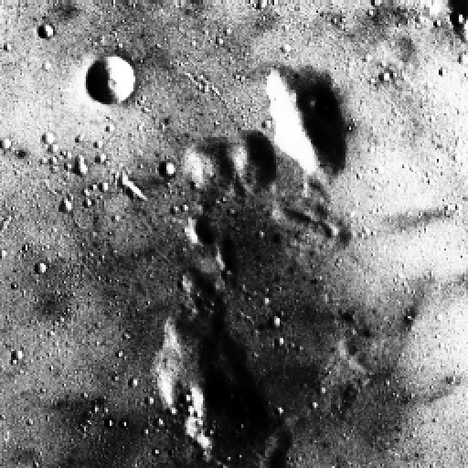
Histogram Modification and Equalization
Original Image
Equalized Image

Slide 30
Analog Processing vs. Digital Processing Example
Low-pass Filtering example:
  Analog: Chebyshev Analog Filter of Type I and Order 6, vs.
  Digital: FIR 129-Tap Filter
Notes:
Digital Systems: Hardware Organization and Design
Architecture of a Respresentative 32 Bit Processor

Slide 31
Chebyshev Analog Filter of Type I
Chebyshev Type I (Pass-Band Ripple)
6-Pole
1.0 dB Pass-Band Ripple
Non-linear Phase
MATLAB: fdatool
  Order = 6
  Fs = 10,000 Hz
  Fpass = 1,000 Hz
  Apass = 1 [dB]
Notes:
Digital Systems: Hardware Organization and Design
Architecture of a Respresentative 32 Bit Processor

Slide 32
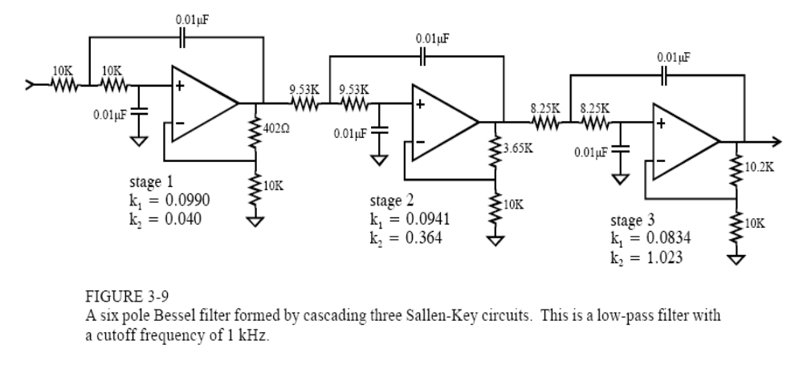
Example of a 3-rd order Active low-pass filter implementation
Notes:
Digital Systems: Hardware Organization and Design
Architecture of a Respresentative 32 Bit Processor

Slide 33
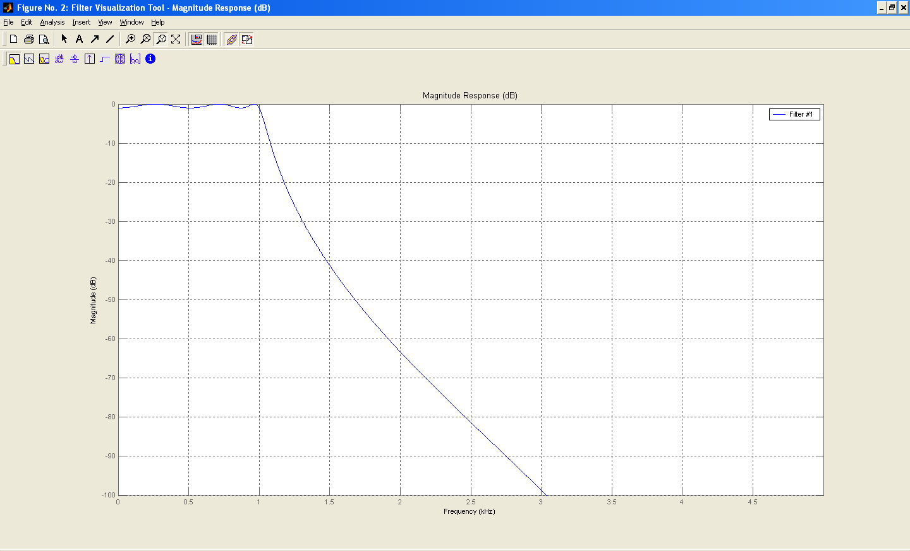
Magnitude Response of Chebyshev Filter Type I Order 6.
Notes:
Digital Systems: Hardware Organization and Design
Architecture of a Respresentative 32 Bit Processor

Slide 34
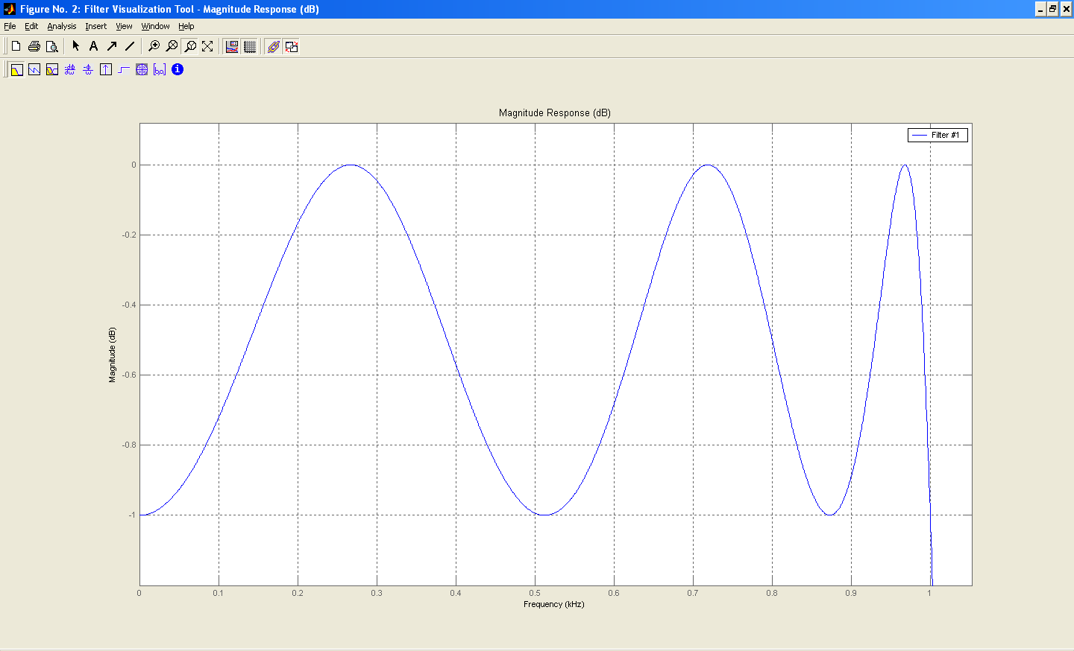
Pass-Band Ripple 1.0 dB
Notes:
Digital Systems: Hardware Organization and Design
Architecture of a Respresentative 32 Bit Processor

Slide 35
Digital Filter Design
FIR,
129-Tap,
Less then 0.002 dB Pass Band Ripple
Linear Phase
Notes:
Digital Systems: Hardware Organization and Design
Architecture of a Respresentative 32 Bit Processor

Slide 36
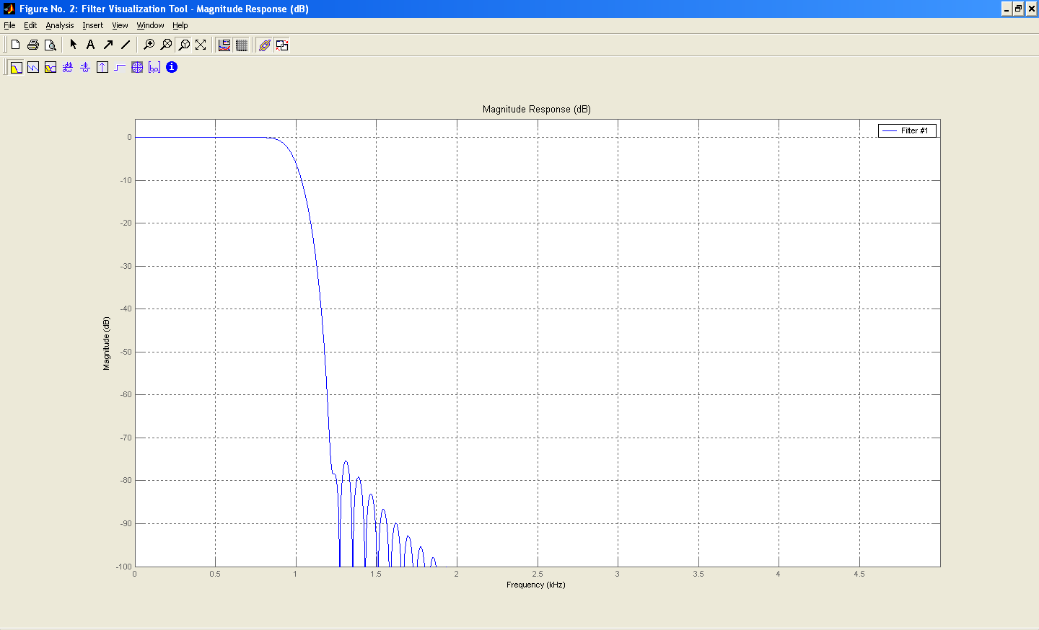
FIR Filter Magnitude Response
Notes:
Digital Systems: Hardware Organization and Design
Architecture of a Respresentative 32 Bit Processor

Slide 37
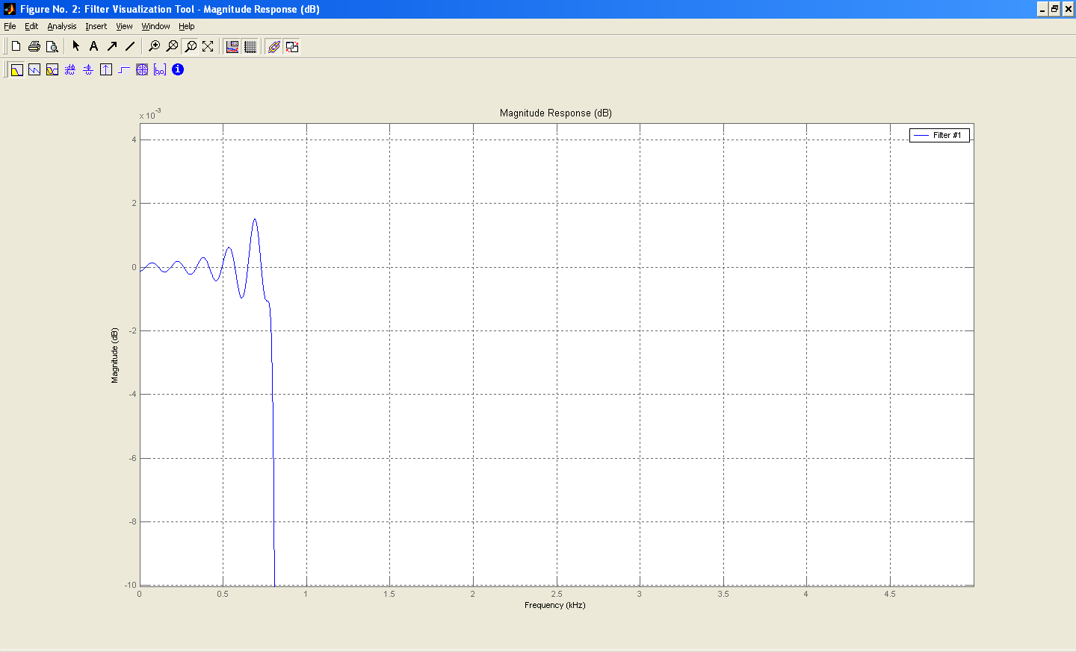
Less then 0.002 dB Pass-Band Ripple
Notes:
Digital Systems: Hardware Organization and Design
Architecture of a Respresentative 32 Bit Processor

Slide 38
Why go digital?
Programmability/flexibility
  The HW can do many things, not just DSP
  Easy to improve or change via SW/HW updates
Repeatability – good for manufacture
  Same performance from one unit to another
  Performance does not change as a function of temperature or age of the circuit
Avoid analog circuit problems
  Difficult layout
  Crosstalk
  Parasitic Effects

Slide 39
Why go digital?
Cost
  10-20 years ago lots of stuff was analog because doing it digitally was much more expensive
  Now (Moore’s law) we can do things cost effectively with digital processing
Saves time
  It is generally much easier to design and debug a digital circuit than an analog circuit
Higher performance
  E.g. CD player vs. vinyl records
No analog option
  If data is already digital (e.g. mp3 decompression)
  Algorithm is complicated and cannot be implemented in analog means

Slide 40
Why go digital?
Instead of many analog components that vary with temperature, process, voltage, age, etc., we have (ideally) just 2 of those components: the ADC and the DAC
the ADC and DAC have a simple function that is consistent for all DSP systems, and therefore can be optimized independently.
There is a very big body of research regarding these ADCs and DACs, as well as many excellent companies and components
ADCs and DACs with excellent performance for almost any application are available

Slide 41
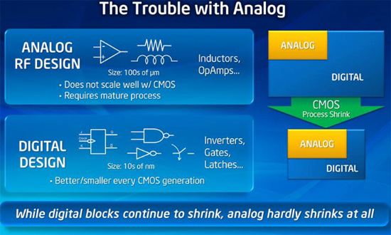

Slide 42
Analog vs. Digital Implementations
Analog
Cons:
  Approximate Filter Coefficients
    Only standard components available
  Environment Temperature dependent
  Less accurate
  Can be used only for designed purpose
Pros:
  Operate in real-time
Digital (DSP)
Cons:
  Real-time operation is dependent on the speed of hardware and the complexity of problem at hand.
Pros:
  Accurate Filter implementation to desired precision
  Operation independent on the environment.
  Flexible
Notes:
Digital Systems: Hardware Organization and Design
Architecture of a Respresentative 32 Bit Processor

Slide 43
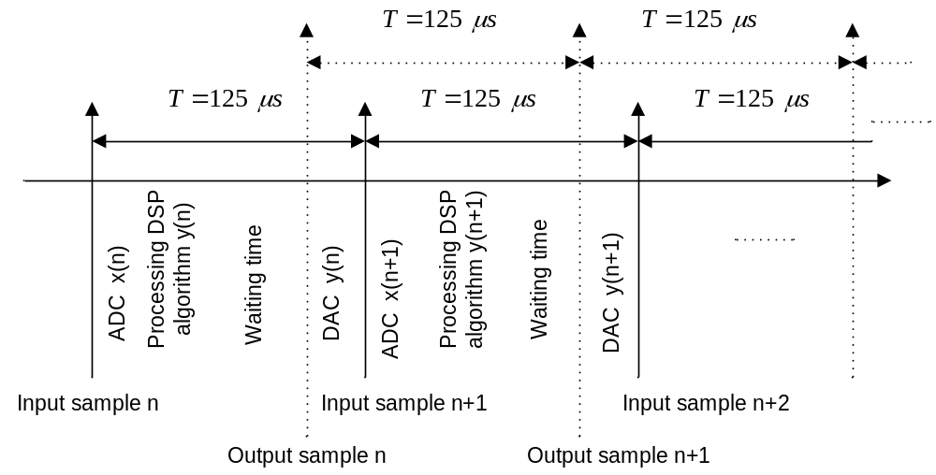
Concepts of the real-time processing

Slide 44
What do we use for DSP?
In general we can use:
  Software
    General Purpose Processor (GPP), e.g. Intel Core i7
    DSP Processor
  Hardware
    ASIC
    FPGA

Slide 45
If we want to do DSP in software…
Digital Signal in
Real-Time
Digital Processing
Digital Signal out
Time-constrained Operation or Transformation
performed on digital signals within a required period
of time to maintain synchronization with occurring events.
Example:
  Processor clocked at 120 MHz and can perform 120MIPS
    Sampling rate = 48KHz (Digital Audio Tape - DAT) number of instructions per sample = (120 x 10⁶)/(48 x 10³) = 2500.
    Sampling rate = 8KHz (voice-band, telephony) number of instructions per sample = 15000.
    Sampling rate = 75MHz (CIF 360x288 Video at 30 frames per second) number of instructions per sample = 1.6 => unfeasible; FPGA/ASIC with pipelining would be better choice

Slide 46
Real-Time Digital Signal Processing on a Processor
Constraints:
  real-time DSP applications limited to cases where the required sampling rate is sufficiently lower than the processor’s instruction rate
  Generally, audio signals can be processed but video processing can be problematic in software only
Challenge:
  Produce working code.
  Produce sufficiently compact code to execute in real-time.
  A sufficient number of instructions need to be performed between sample periods.

Slide 47
What is Special about DSP Applications?
Large number of samples being continuously fed to the system (samples or blocks).
Repetitive Operations:
  The same operation being applied to different set of samples
  Parallel processing
Vector and Matrix Operations
Real time operations

Slide 48
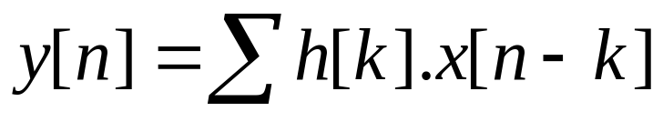
Example: Digital Filtering
The two most common real-time digital filters are:
  Finite Impulse Filter (FIR) – really a weighted running average
  Infinite Impulse Filter (IIR)
The basic FIR Filter equation is
  where h[k] is an array of constants
In C language
y[n]=0;
For (n=0; n<N;n++)
{
For (k = 0;k<N;k++)
//inner loop
y[n] = y[n] + h[k]*x[n-k];}
Only Multiply and Accumulate (MAC) is needed!

Slide 49

MAC using General Purpose Processor (GPP)
11
12
3
R0
11
24
9
R2
X
44
R1
1
2
3
 | Clr | A | ;Clear Accumulator A
 | Clr | B | ; Clear Accumulator B
Loop | Mov | *R0, Y0 | ; Move data from memory location 1 to register Y0
 | Mov | *R1,X0 | ; Move data from memory location 2 to register X0
 | Mpy | X0,Y0,A | ;X0*Y0 ->A
 | Add | A,B | ;A + B -> B
 | Inc | R0 | ;R0 + 1 -> R0
 | Inc | R1 | ;R1 + 1 -> R1
 | Dec | N | ;Dec N (initially equals to 3)
 | Tst | N | ;Test for the value
 | Jnz | Loop | ;Different than zero loop again
 | Mov | B,*R2 | ;Move result to memory

Slide 50
MAC using DSP
11
12
3
11
24
9
R2
X
44
1
2
3
 | Clr | A | ;Clear Accumulator A
 | Rep | N | ; Rep N times the next instruction
 | MAC | *(R0)+, *(R1)+, A | ; Fetch the two memory locations pointed by R0 and R1, multiply them together and add the result to A, the final result is stored back in A
 | Mov | A, *R2 | ; Move result to memory

Slide 51
GPP Drawbacks
More instructions/task
Common Memory for data and program
  Limited bus/memory bandwidth
Solution : DSP Architectures

Slide 52
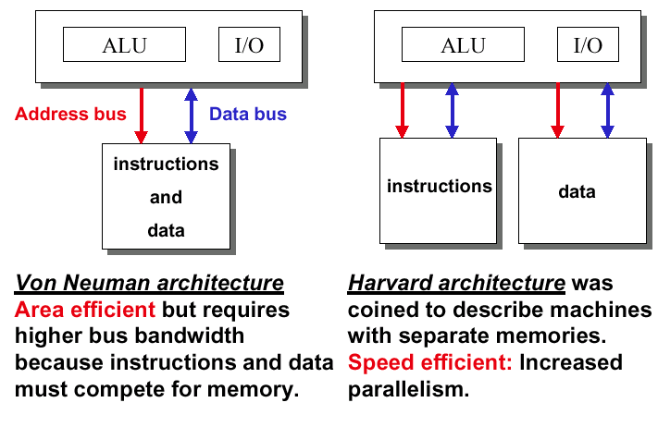
Memory structures

Slide 53
GPP – Data Path Only
Memory Data Bus
Memory
Register 1
Register 2
ALU
Same memory for program and data

Slide 54
Digital Signal Processors – Data Path Only
Program Memory Data Bus
Data Memory Data Bus
Program Memory
Data Memory
Multiplexer
Multiplexer
A DSP Chip is a microprocessor specially designed for DSP applications
Harvard architecture allows multiple memory reads
Architecture optimized to provide rapid processing of discrete time signals, e.g. Multiply and Accumulate (MAC) in one cycle
ALU
Accumulator

Slide 55
Digital Signal Processor - Overview
DSP Core includes:
  Address buses
  Data buses
  Data arithmetic logic unit (ALU)
  Address generation unit (AGU)
  Program controller
  Bit-manipulation unit
  Enhanced debugging module
Peripherals on chip
  Timer
  serial link
  communication links
    DSP to DSP
    Ethernet
    ATM
  host ports
  input/output pins
Adaptation for FFT
  bit reverse addressing
Special instructions
  Parallel move support
  Loop instructions; special hardware instructions (e.g., FIR)
Data memory
On-chip Peripherals
DM
Core
PM
Program Memory

Slide 56
Software Coding
Write Code in C (closest high-level language to assembly)
Compile to create Assembly code
Assemble the code to create object code and link
Use simulator to test the speed of the code
If code is not fast enough - rewrite the C code and test again. If not fast enough yet, write in Assembly language

Slide 57
Why use Assembly?
Most C compilers for DSP chips produce code that does not fully utilize the capabilities of the DSP
  Data Fetch parallel to execution
  Parallel execution
The C code can be 3 to 30 times slower than the best assembly code possible. Especially in the signal processing parts of the code.
The problem is more acute with fixed-point DSPs
Writing in assembler is a real pain, so using DSP processors is not so much fun in my opinion

Slide 58

But I don't want to write Assembly
Have somebody else write assembly for you
  use libraries (not always available)
Rewrite your C code to produce a better assembly code (not always possible)
Test and profile your code to see which parts of the software take most of the CPU time. Limit Assembly code to subroutines:
  That the program spends a lot of time in them
  That benefit from the special functions of DSP such as MACS and parallel execution and fetch.
Bottom line is – assembly code is not fun, and the double-buffering that is often required for real-time applications is complicated

Slide 59
How to Write a Better C Code
Use Simple Loops
Avoid if statements in loops
Avoid subroutine calls statements in loops
Use inline subroutines
  Compiler inserts function directly into the caller's code stream (conceptually similar to what happens with a #define macro)
  Avoids the subroutine call over head (saving volatile variables)
  Increases code size
Avoid division and modulo operations
Use and (&) and shift when possible
Use 5%/80% rule
  Program in Assembly the 5% of the lines of code of the project that take 80% of the CPU load.
  Try to change your code to fit existing assembly routines.

Slide 60
Evolution of DSP Processors
Low end conventional DSP processors:
  Single multiplier or MAC unit and an ALU, one MAC/cycle.
  Operate at around 20-50 MHz, and provide good DSP performance
  Low power consumption and memory usage.
Midrange conventional DSP Processors:
  Increased clock speeds operating at 100-150 MHz.
  Include additional hardware, such as a barrel shifter or instruction cache, with a deeper pipeline to improve performance.

Slide 61
Very Large Instruction Width (VLIW)
VLIW architectures execute multiple instructions/cycle and use simple, regular instruction sets
  More parallelism, higher performance
  Better compiler target
Multiple independent instructions per cycle, packed into single large "instruction word" or "packet“
Large, uniform register sets
Wide program and data buses

Slide 62
VLIW – Simplified Architecture Example
Program
Memory
256 bits consisting of 8 instructions
Each instruction is 32 bits
Execution
Units
Execution
Units
Execution
Units
Execution
Units
Execution
Units
Each unit executing one instruction
Execution
Units
Execution
Units
Execution
Units

Slide 63
VLIW architecture
Why: DSP task is relatively predictable
  Parallel datapath gives higher performance
How:
  Multiple instruction issues per-cycle
  Compiler manages data dependency
Challenges
  Memory issue and on chip connections
  Register (fan-out ports) costs

Slide 64
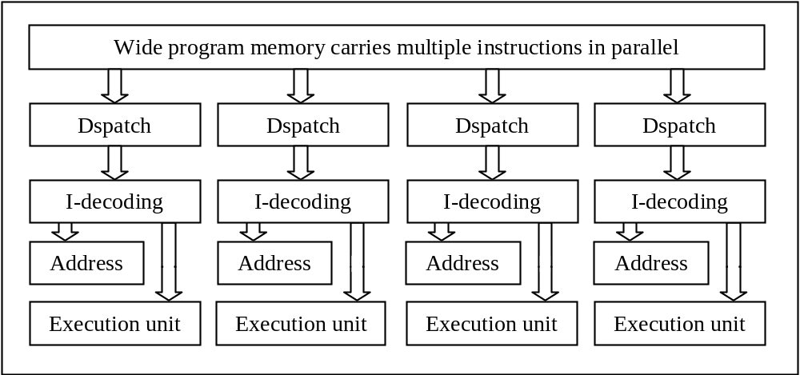
VLIW DSP including control path

Slide 65
DSP versus GPP
Multiple parallel units
  multiply accumulate (possibly several units)
  address calculation in parallel to processing
  barrel shifter
Memory Access
  special ALU for address calculation
  Bit reversed addressing
  circular addressing
Automatic loops
  Software looping: writing assembly code to perform branching
  Hardware looping: dedicated hardware loop counter register
Hardware support for managing arithmetic computation (in GPP it needs multiple cycles)
  Shifters
  Guard bits
  Saturation
Preventing
Overflow!!

Slide 66
DSP Implementation of the FIR Filter
129-tap digital filter requires 129 multiply-accumulates (MAC)
Operation must be completed within sampling interval (1/F_{s}) to maintain real-time.
  F_{s}=10000Hz = 10kHz ⇒ 100 μs
  ADSP-21xx family performs MAC process in single instruction cycle
  Instruction rate > 129/100 μs = 1.3 MIPS
  ADSP-218x 16-bit fixed point series: 75 MIPS.
Notes:
Digital Systems: Hardware Organization and Design
Architecture of a Respresentative 32 Bit Processor

Slide 67
DSP Processors and Manufacturers
Texas Instruments
Analog Devices
NXP
Renesas
Many more

Slide 68
Fixed-point and Floating-point Formats
There exist fixed-point and floating-point DSP processors depending on how their CPUs perform arithmetic
A fixed-point DSP processor represents data in 2’s complement integer format and manipulates data using integer arithmetic
A floating-point processor represents number using a mantissa (fractional part), and an exponent

Slide 69
Fixed Point Vs Floating Point
Fixed Point/Floating Point
  fixed point processor are :
    cheaper
    smaller
    less power consuming
    Harder to program
      Watch for errors: truncation, overflow, rounding
    Limited dynamic range
    Used in 95% of consumer products
  floating point processors
    have larger accuracy
    are much easier to program
    can access larger memory
  It is harder to create an efficient program in C on a fixed point processors than on floating point processors

Slide 70
DSP Processor Selection Criteria
Wide range of DSP processors are available, which one to select?
It depends about the application: what is the most important criteria?
  Speed.
  Memory bandwidth.
  Cost.
  Ease of use of development tools.
  Packaging options.
  On-chip integration.
  Power consumption.

Slide 71
DSP Processor Targets: Pager
Controlled by Power Management Unit
RF
Receiver
Microcontroller
Chip
Pager
Peripherals
ADC
Pager Protocol
Decoder
DAC
DSP
Chip
Spread Spectrum Decoding
Compression
Speech Processing
FLEX™ is a popular pager protocol created by Motorola
http://www.motorola.com/

Slide 72

DSP Processor Targets: Cell Phone
Controlled by Power Management Unit
RF
Receiver
Microprocessor
Chip
Cell
Peripherals
RF
Codec
Voice
Codec
DSP
Chip
Speech Coders
Speech Recognition
Equalizers
Antenna noise cancellation
Image enhancement techniques

Slide 73
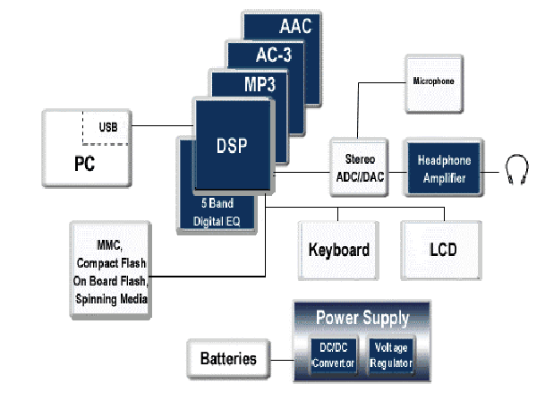
DSP Targets: Voice Over IP

Slide 74
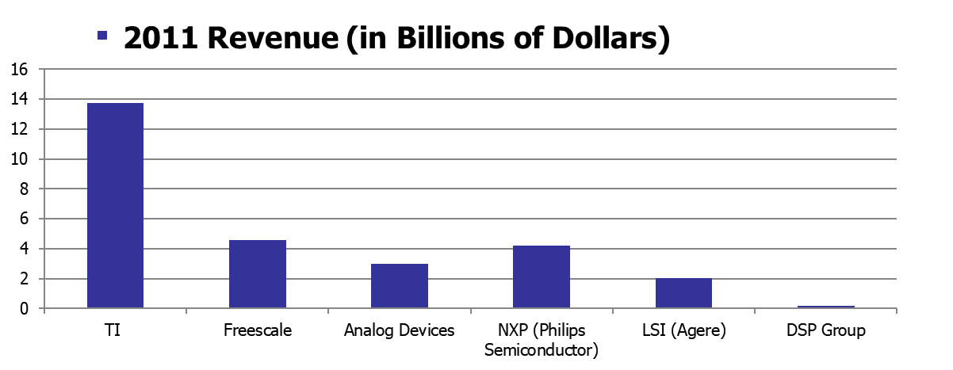
DSP Market – Ranking
Ranking:
Texas Instruments
Freescale Semiconductor
NXP
Analog Devices
LSI (Agere)
DSP Group
Ref:
http://investor.ti.com/fininfo.cfm
www.freescale.com
www.analog.com
http://www.nxp.com
www.lsi.com
www.ir.dspg.com

Slide 75
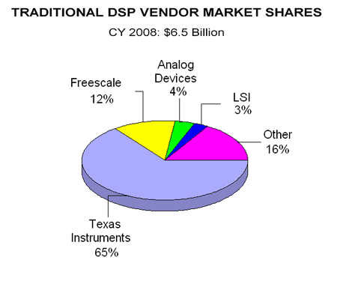
DSP Market – By Company
Ref: Forward Concepts
http://www.fwdconcepts.com/dsp5409.htm

Slide 76
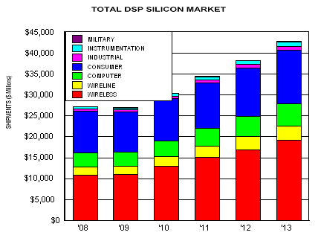
DSP Market – By Application
Communications applications (e.g., wireless)
Jumped from 11,000 Million $ in 2008 to 17,000 Million $ in 2012.
Expectations:
DSP market will increase by 14% in 2012
Ref: Forward Concepts
http://www.fwdconcepts.com/DSP'09/index.htm

Slide 77
Portable Applications – Need High Performance Processors
Ultra Low power
High Performance
Cost Effective
Power
Year: 2016
Performance
Low power
Average Performance
Cost Effective
Ref: http://www.xilinx.com
Year: 1999
Time

Slide 78
Portable Applications
Embedded signal and image processing tasks are becoming more demanding
  Wireless communications (e.g., 4G/LTE, UWB): higher data rates, more complex systems and air interfaces
  Video processing (DTV, HDTV, Camcorders, 3DTV): compression, decompression, enhancement, superresolution, feature extraction
  Still image processing: cameras, copiers, printers, image-based rendering
High performance is required: 100s to 1000s of GOP
High efficiency: 100s of MOPS/mW (GOPS/mW), 10s GOPS/$
Programmability: multiple modes, evolving standards, evolving features

Slide 79
Enhancing DSP Architectures
More parallelism
  Increase the number of operations that can be performed in each instruction
    Adding More Executing units (e.g., Multipliers)
  Increase the number of instructions that can be issued and executed in every cycle
Highly specialized hardware in core
Co-processors
Multi-Core DSPs

Slide 80
Why Consider DSP Processor Alternatives
Wireless Systems requires more and more high performance and higher bandwidth
DSP processor performance might not be enough for future applications
Performance
4G/LTE
Advanced
~10,000,000MIPS
1 Gbps – 500+ Mbps
3G
~100,000MIPS
384-3000 Kbps
2.5G
~10,000MIPS
64-384 Kbps
2G
~100MIPS
8-13 Kbps
Bit Rate

Slide 81
What are the alternatives to a DSP Processor
Alternative (?): we already discussed software que that runs on a GPP
  Biggest issue: not optimized for DSP, compensates with higher clock, thus uses up more energy
  Not good for portable applications

Slide 82
What are the alternatives to DSP processor (2)
High-performance GPPs with DSP enhancements.
  Eliminating the need of a DSP and GPP for many products and thus reducing cost
  Example: Intel® Core™ Microarchitecture (i3,i5,i7)
    Two Single Instruction Multiple Data (SIMD) instructions allowing identical operations on multiple pieces of data in parallel.
    Intel Core instruction scheduler can issue four instructions simultaneously across five logical units: one Load and one Store unit, and three Arithmetic-Logical Units (ALUs)
    Intel® Advanced Vector Extensions (Intel® AVX) new three- and four operand (non-destructive) instructions, 256-bit primitives for data permutes
    Power performance is generally still not good enough for portable applications
Multi-Core DSPs
Hardware implementation
  Application Specific Integrated Circuits (ASIC)
  Field Programmable Gate Array (FPGA)

Slide 83
Parallel processing in ASIC or FPGA
Simply put, we implement parallelism with digital logic. The only thing limiting us is the amount of logic and pins available on the chip.
11
12
3
R0
11
24
9
R2
X
44
1
2
3
R1
22
24
6
C0
66
144
54
C2
3
6
9
X
264
C1

Slide 84
ASIC - Advantages
Speed (best)
Reduced Power Consumption (best)
Cost/performance (best in large quantities)
Overall Capability For Design Task (Best)

Slide 85
ASIC- Disadvantage
Large development costs
Lengthy development cycles
Inflexibility
Another Solution
FPGA

Slide 86
FPGA - advantages
Much higher parallelism than DSP processor (orders of magnitude)
More flexible than ASIC or DSP processor
Development cycle is much faster than that of an ASIC
Development cycle is much easier than that of an ASIC
Very high performance – can rival ASICs in many applications
Reusability of the HW for many applications via FPGA reconfiguration

Slide 87
FPGA - disadvantages
Sometimes more expensive than DSP processor
Sometimes less energy efficient than DSP (definitely less energy efficient than an ASIC)
Requires HDL and digital design knowledge that is harder to learn and than software programming (arguable – because DSP processor requires good assembly programming that is also difficult)

Slide 88
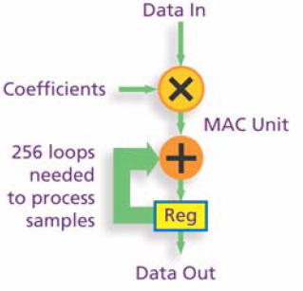
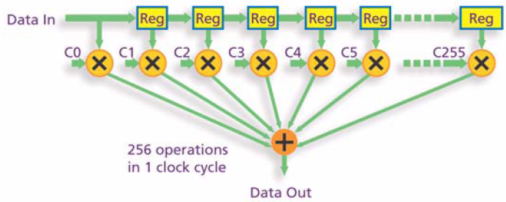
DSP and FPGA
FPGAs Parallel Approach to DSP Enables Higher Computational
Throughput
Consider a 256-tap FIR filter:
Conventional DSP Processor – Serial Implementation
FPGA – Fully parallel implementation

Slide 89
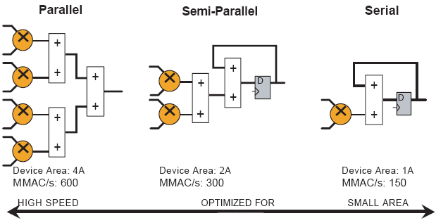
Flexibility of FPGAs
Different ways of implementing four multiply-accumulate (MAC) functions.

Slide 90
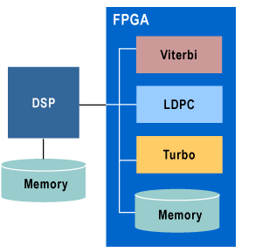
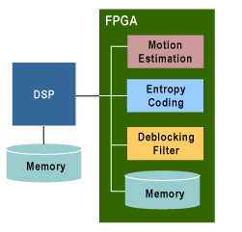
Co-processing with a FPGA
FPGA co-processors are an extremely cost-effective means of off-loading computationally intensive algorithms from a DSP processor.
FPGA Coprocessor for WiMAX Baseband Processing
FPGA Coprocessor for High-Definition H.264 Encoding

Slide 91
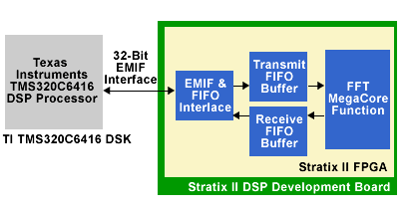
FFT Co-Processing Example
FFT co-processor implemented within an Altera Stratix FPGA and connected to a Texas Instruments DSP via the 32-bit external memory interface (EMIF)
Develop co-processor from intellectual property (IP) such as FFT MegaCore
FFT implementation with only the TI DSP processor
TI DPS running at 720 MHz completed the 1024-point 16-bit FFT in 9.06 μs
FPGA Co-processor implementation
At 278 MHz completed the transform in only 4.64 μs
FFT Co-processor on Stratic FPGA

Slide 92


Performance Evolution of FPGA versus DSP Processors

Slide 93
Why Still use DSP Processors?
Several applications are not suited to be implemented in FPGAs/ASICs
  Parallelism is sometimes inherently limited
  Speed is not always the highest factor to consider (perhaps power or cost)
FPGA is relatively expensive for terminal products (e.g., cell phones) and ASICs are only feasible cost-wise if a large quantity is made

Slide 94
When will we use an FPGA for DSP applications?
We should always think if an FPGA is appropriate
Usually the best fits are applications that require:
  a lot of parallelism
  a fast data clock
  fast development time of product
  high performance
FPGAs therefore have a very high presence in military, telecom backbone, radar, and image processing applications, for example

Slide 95
When will we not use an FPGA for DSP?
Some DSP applications are not suited for FPGAs or can be done more cheaply with DSP processors
  Parallelism is limited and/or data rate is low (e.g. one audio stream)
FPGAs are still usually too expensive for final products or they use too much power
  In this case, an ASIC would be developed for the DSP application but since ASICs are prototyped using FPGAs, FPGAs will still be used during the ASIC development

Slide 96
ASIC Prototyping
FPGAs are commonly used for ASIC Prototyping
In this way, errors in ASICs are caught before manufacture and respins are avoided.
Making an ASIC without first prototyping via FPGAs is playing with fire
Therefore, even if we choose to use an ASIC, we need to know how to design with FPGAs
Moreover, there are established processes to move from FPGAs to ASICs (e.g. Altera Hardcopy)
Needless to say, both FPGAs and ASICs are designed with HDLs so there is a lot of commonality in the knowledge needed

Slide 97

ASIC Prototyping with FPGAs (an FPGA of FPGAs!!!)

Slide 98
Conclusions
These days virtually all electronic devices contain some Digital Signal Processing (DSP) elements.
Implementation options are in general:
  Software (GPP, DSP Processor)
  Hardware (ASIC, FPGA)
We use FPGAs when we need high performance and/or high parallelism and/or fast product development.
Even if we choose to make a DSP ASIC, prototyping of the ASIC will be done using an FPGA.
Therefore, every computer and electrical engineer must know how to use FPGAs for DSP .

